Slide 1

UNIT-I
Introduction to Embedded Systems
Introduction to Embedded systems: What is an embedded system , ES Vs. General computing system, history, classification, major application areas, and purpose of embedded systems. Core of embedded system, memory, sensors and actuators, communication interface, embedded firmware, other system components, PCB and passive components.

Slide 2
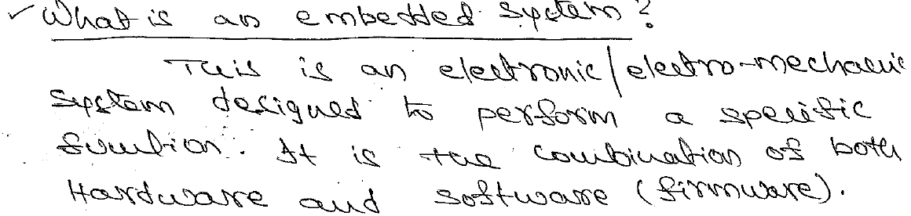
Embedded System Definition

Slide 3
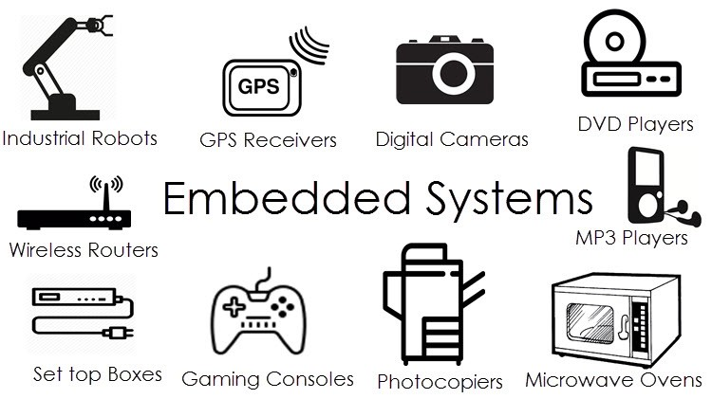
Examples

Slide 4
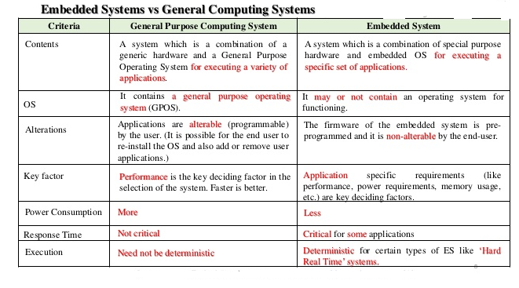
Embedded system Vs. General computing system

Slide 5
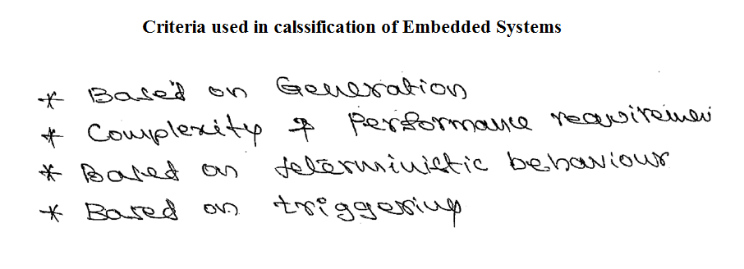
Classification of Embedded Systems

Slide 6
Classification based on generation
This is based on the order in which ES are evolved.
First Generation
Second Generation
Third generation
Fourth Generation

Slide 7
Classification based on Complexity and Performance
Small-Scale Embedded Systems
Medium-Scale Embedded Systems
Large-Scale Embedded Systems/ Complex Embedded Systems

Slide 8
Classification Based on Deterministic Behavior
Deterministic
Non-Deterministic

Slide 9
Classification Based on Execution Behavior
Hard Real Time
Soft Real Time

Slide 10
Major Application Areas of Embedded Systems
Consumer Electronics
Household Appliances
Home Automation & Security Systems
Automotive Industry
Telecom
Computer Peripherals
Networking Systems
Health Care

Slide 11
Measurement and Instrumentation
Banking and Retail
Card Readers

Slide 12
Purpose of Embedded Systems
Data Collection /Storage/ Representation
Data Communication
Data / Signal Processing
Monitoring
Control
Application Specific User Interface

Slide 13
Core of Embedded Systems
General Purpose and Domain Specific Processors
        Micro Processor
        Micro Controller
        Digital Signal Processor

Slide 14
Application Specific Integrated Circuits (ASICS)
Programmable Logic Devices ( PLD’s)
Commercial off-the –Shelf Components ( COTS)

Slide 15
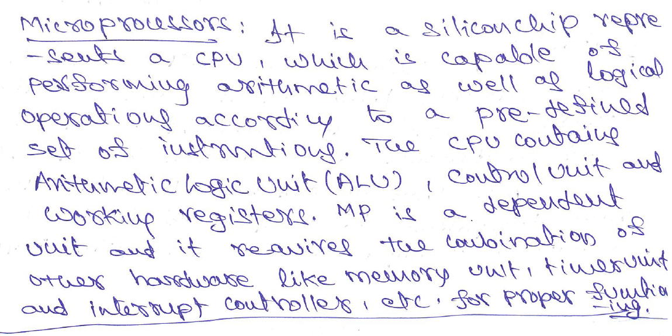
Microprocessor

Slide 16
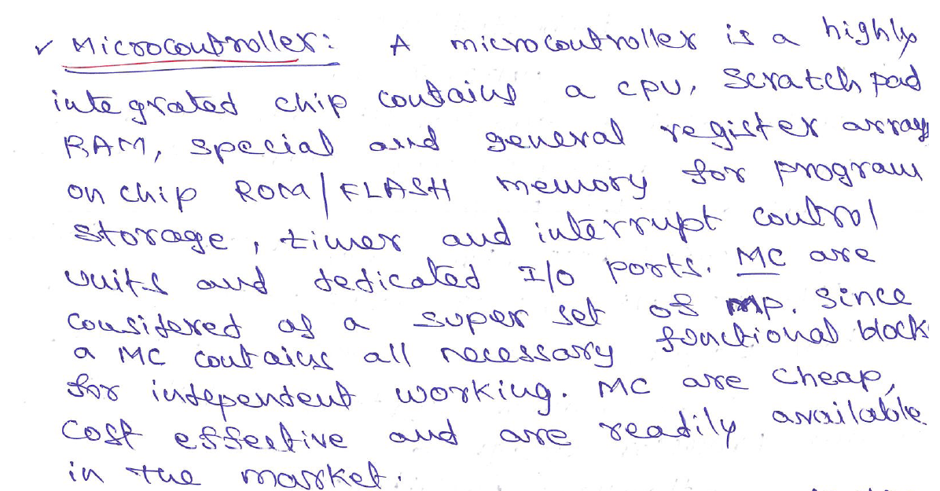
Micro Controller

Slide 17
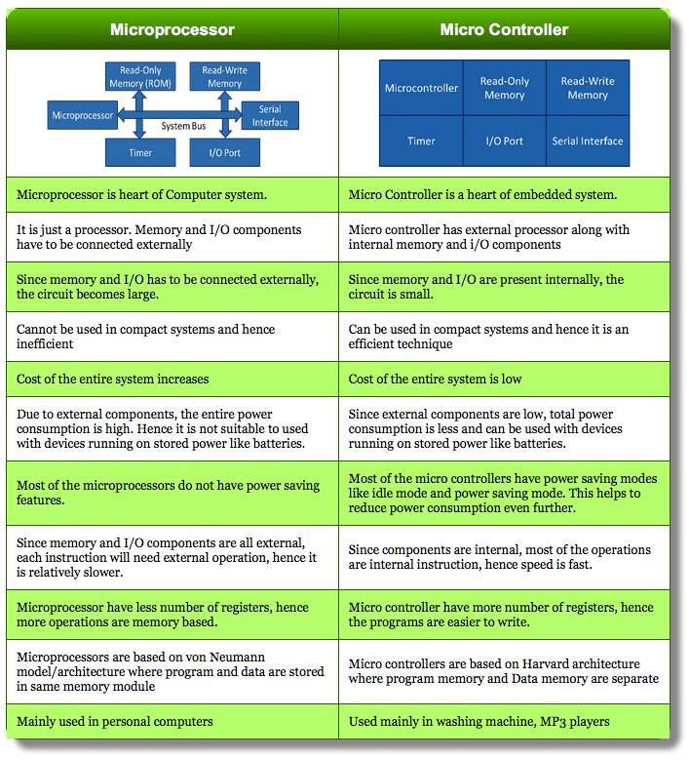
Differences Between MP and MC

Slide 18
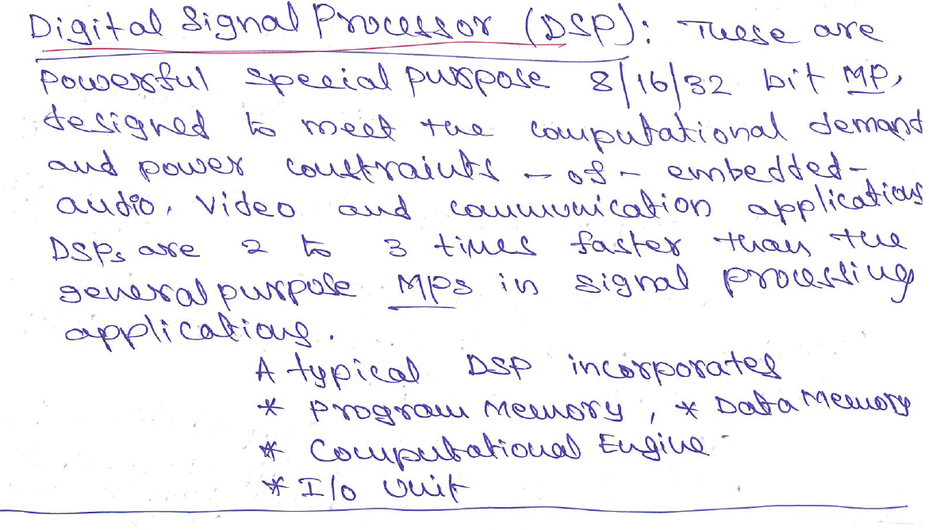
Digital Signal Processor

Slide 19
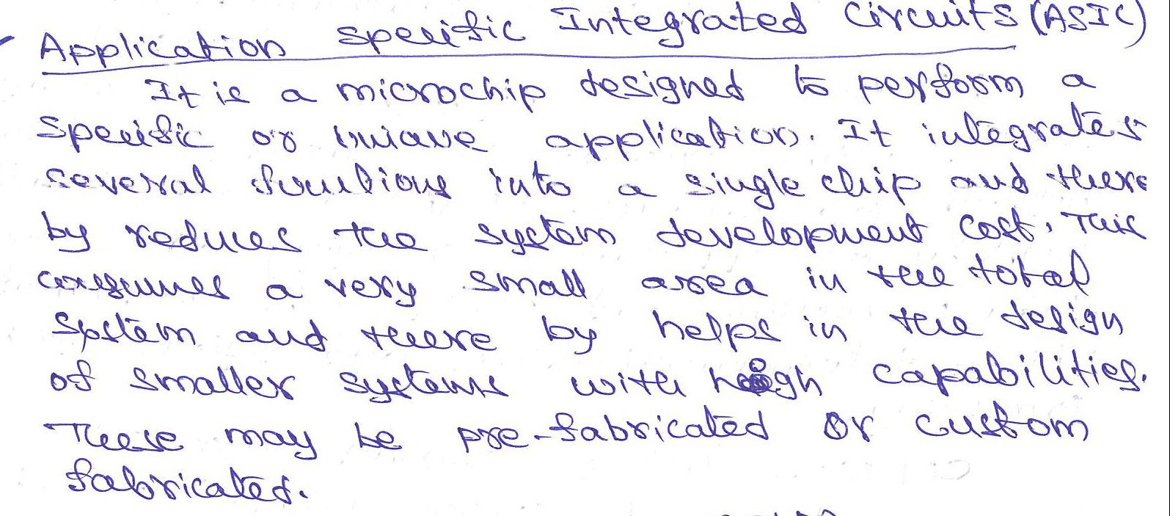
Application Specific Integrated Circuits (ASICS)

Slide 20
Programmable Logic Devices ( PLD’s)
Logic devices provide specific functions, including device-to-device interfacing, data communication, signal processing , data display , timing and control operations and almost every other function a system perform.
These may be
  Fixed
  Programmable

Slide 21
PLD’s offer customers a wide range of logic capacity , features , speed and voltage characteristics – and- these devices can be re-configured to perform any no.of functions at any time.
There are two major types of PLDs
    Field Programmable Gate Arrays (FPGAS)
    Complex Programmable Logic Devices (CPLDS )

Slide 22
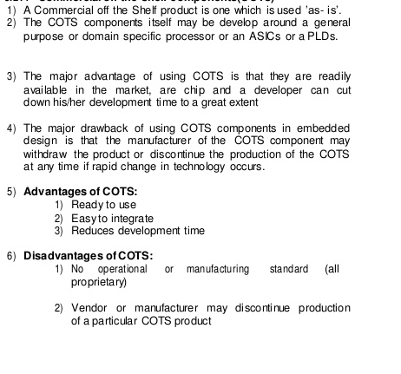
Commercial off-the-shelf components
( COTs)

Slide 23
Memory
Types of memory used in ES
      Program Storage Memory (ROM)
      Read-Write Memory / Random Access memory (RAM)
ROM:
        MROM (Masked ROM)
        PROM ( Programmable Read Only Memory )
        EPROM ( Erasable Programmable ROM)
        EEPROM ( Electrically Erasable PROM)

Slide 24
RAM:
      SRAM (Static RAM)
      DRAM ( Dynamic RAM)

Slide 25
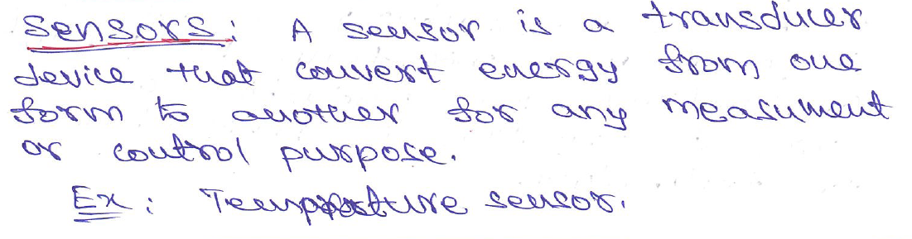
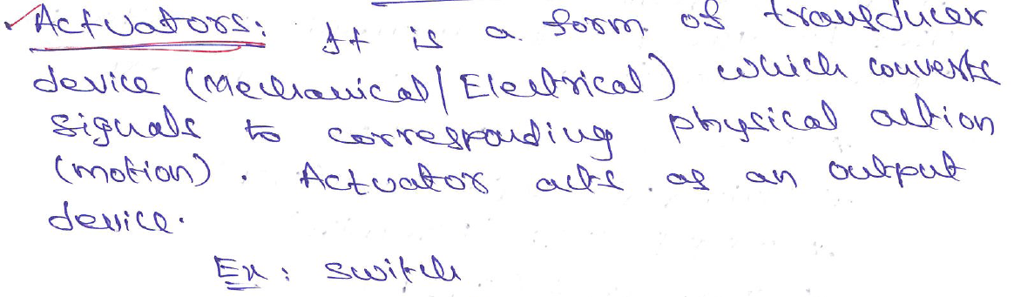
Sensors and Actuators

Slide 26
Communication Interface
Device / Board Level Communication Interface.
Product Level Communication Interface
( External Communication Interface )

Slide 27
On Board Communication Interface
Inter Integrated Circuit (I2C)
Serial Peripheral Interface (SPI) Bus
Universal Asynchronous receiver Transmitter(UART)
1- Wire Interface
Parallel – Interface

Slide 28
External Communication Interface
RS-232 C and RS-485
Universal Serial Bus
IEEE 1394 ( Fire-Wire)
Infrared (IrDA)
Bluetooth (BT)
Wi-fi
Zig Bee
General Packet Radio Service (GPRS)

Slide 29
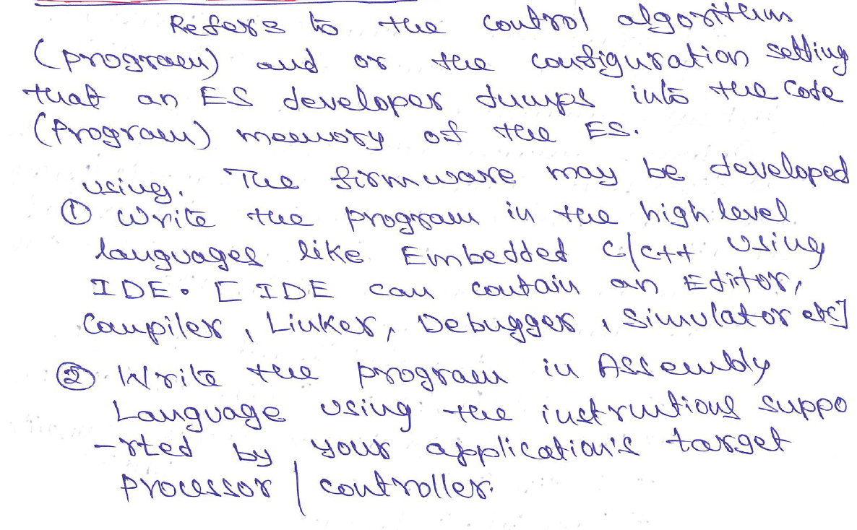
Embedded Firmware

Slide 30
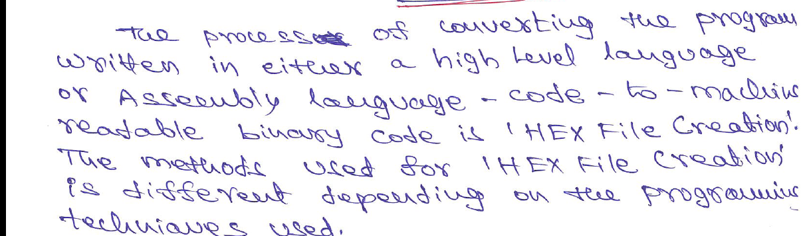
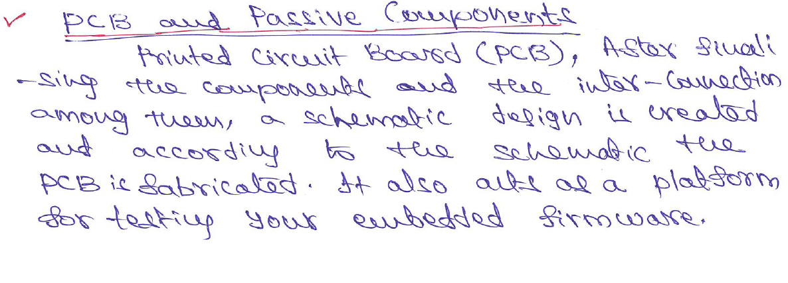

Slide 31
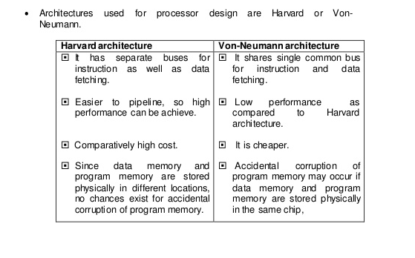
Processor Architectures

Slide 32
